Slide 1
Contemporary latin music

Slide 2
CUBAN MUSIC
Cuba is famous for its music.
Salsa (meaning “sauce”) is the product of various Cuban musical genres including the Afro-Cuban cha cha and mambo, and the bolero from Spain.
Salsa developed in New York City in the 1960s. It can also incorporate North American music styles such as jazz. Salsa also occasionally incorporates elements of rock, R&B and funk.
Instruments include piano, Spanish style guitar, electric guitar, bongos, congos, timbales, trumpet, trombone, claves, cowbell, maracas, guiro, double bass, electric bass, flute, saxophone, violin, tres cubana (a Cuban version of a guitar with 6 strings based over 3 notes in octave pairs) and the laoud (a lute type instrument with 12 strings in octave pairs).

Slide 3
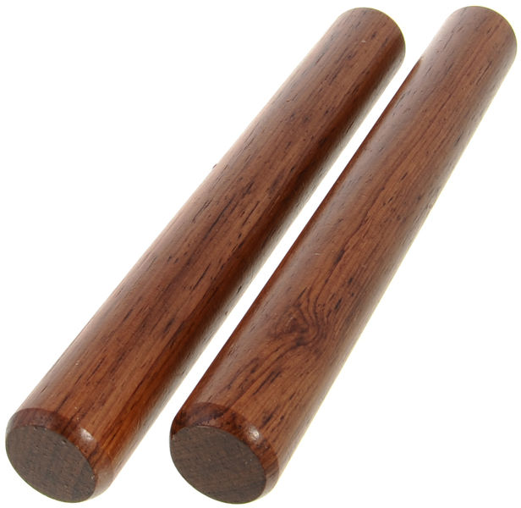
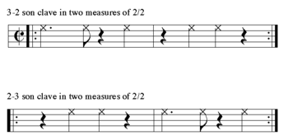
CLAVE
All Cuban music is based around an underlying rhythmic pattern known as “Clave”.
This has become the basis for all Latin music.
Learn the Clave pattern here
Currently the most famous song with a Clave rhythm is the Spanish dance song by Los del Río: Macarena

Slide 4
CUBAN MUSIC
Buena Vista Social Club is an ensemble of experienced Cuban musicians established in 1996 to revive the music of pre-revolutionary Cuba.
The album was produced by American guitarist Ry Cooder and released in 1997.
The project involved both veteran and younger musicians. The oldest musician was 89 year old Compay Segundo.
Compay composed the track “Chan Chan” which tells the story of a couple - Chan Chan and Juanica - who are building a house and go to the beach to get some sand.
His surname Segundo was a nickname given to him because he sang the second part, ie. the bass harmony.

Slide 5
“Chan Chan” performed by Buena vista social club at the Carnegie hall

Slide 6
“da camino a la vereda” performed by Buena vista social club

Slide 7
“El Cuarto De Tula” performed by Buena vista social club

Slide 8

Buena vista social club
Pianist ruben Gonzalez performing with ry cooder
Ruben Gonzalez created the modern Cuban piano sound which was developed from the mambo with added jazz harmonies.
On the Buena Vista Social Club album, he composed the
piano track “Pueblo Noevo”. This starts with the danzon rhythm
(a slow 2/4) followed by a mambo section.
Solos are played by the piano, trumpet and bass. Often soloists will reference other melodies in their improvisation. In this tune the trumpet plays the opening lines from the jazz number “Stormy Weather”.

Slide 9
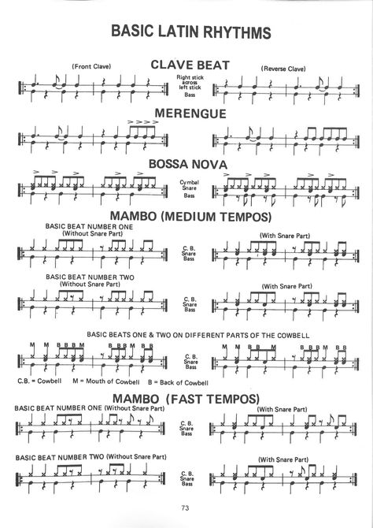
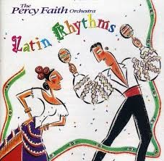
Salsa
Samba
Rhumba
Samba
Tango
Beguine
Calypso
Mambo
Cha Cha
Merengue
Bossa Nova
Danzon
Bolero
Habernera

